Slide 1
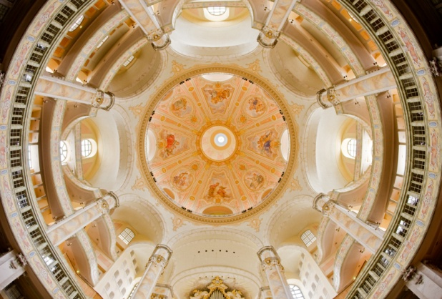
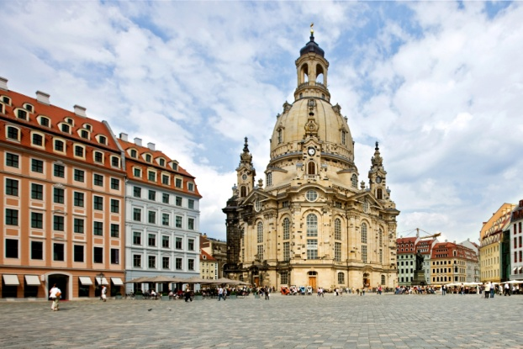
The Renaissance
Chapter 7

Slide 2
Foldables, pg. 381
The Renaissance
The Renaissance Begins
New Ideas and Literature
Renaissance Art
For each section, write or draw at least five important facts. You can look at pictures, maps, big ideas, vocabulary, articles, etc. You don’t NEED to read everything. Please label your drawings, or write entire ideas on each section. (not just one word info or drawings with no labels). We are PREVIEWING this chapter.

Slide 3
Chapter 7, Section 1 Terms
Florence- where was it and why was it important?
Venice- why was it important and what was the head of state called?
Marco Polo- what did he write?
Medici
Niccolo Machiavelli- what did he write?
Renaissance
Secular
Doge
Diplomacy
Florin (not in bold)

Slide 4
Answers to Section 1 questions:
Renaissance means “rebirth.” This was a period of interest in art and learning.
Secular means that people were more interested in the world than in religion and getting into heaven.
The Italian city states grew wealthy because of trade. Most had coastlines (peninsula) and ports where ships could dock.
Italy was the center of the Roman Empire and ruins and art surrounded them. By the 1300s Italy's cities were wealthy and could pay painters, sculptors, and architects to create new works of art. Small city states like Florence and Venice competed with each other to bring fame.

Slide 5
Continued:
Marco Polo’s book increased interest in China and made many people want to buy China’s goods.
Machiavelli claimed that people were greedy and self-centered. He believed rulers should not try to be good, but they should do whatever they needed to keep power and protect their city. This included killing and lying.

Slide 6
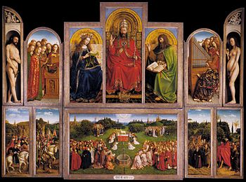
The Italian Renaissance (1.1)
Renaissance means “rebirth”
1350-1550 are called the Renaissance because of a renewed interest in art and learning.
Stressed strength of the individual.
People became more secular, or focused on this world.

Slide 7
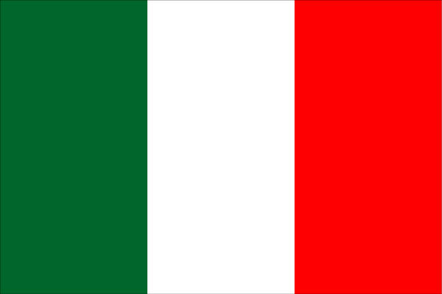
Italian City-States
Italy was divided into city-states.
Florence, Venice, Genoa, Milan, and Rome
City-States became wealthy through trade.
They competed with each other, and wanted artists to produce works that increased their fame.
City-States became wealthy because:
  Most of them had ports (for trading)
  Many skilled artisans lived in them
  The Silk Road was protected by the Mongols
Italian City-States were run by a powerful, wealthy ruler or family.

Slide 8
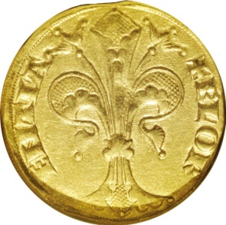
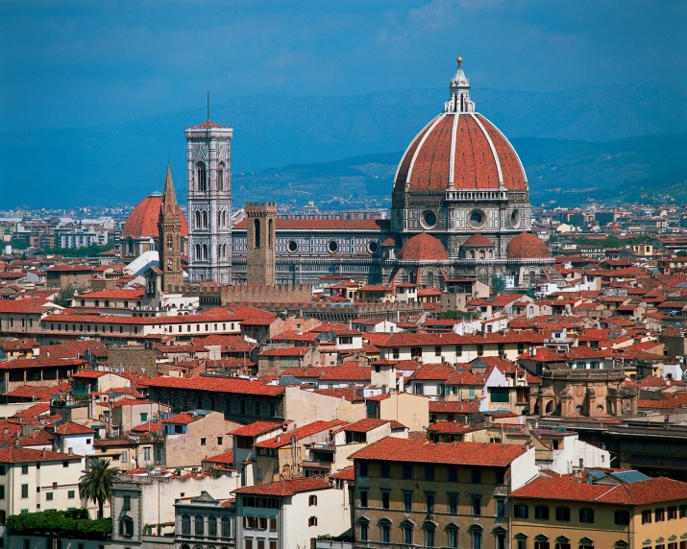
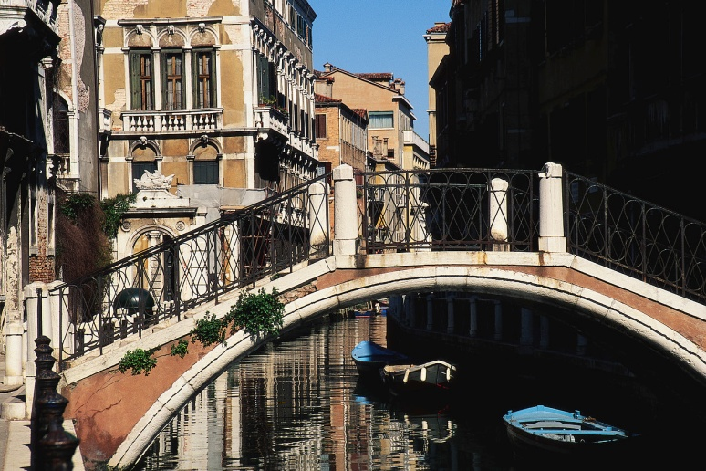
More City-States
Florence was the first Italian city to play an important role in the Renaissance.
The florin, a gold coin, was used in Florence
Florence’s wealth came from trading cloth and banking.
Venice was the wealthiest of all, and was run by a head of state called a doge.
Venetians built canals instead of roads due to swampy islands.

Slide 9
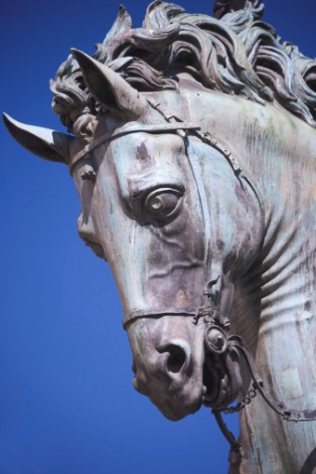
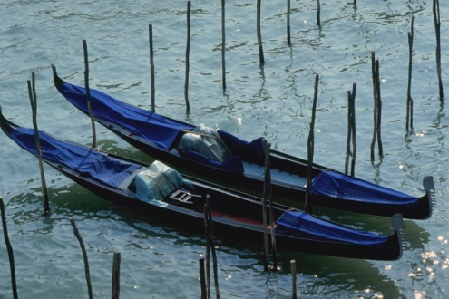
Italian Accomplishments
Venetians became expert shipbuilders because their city was built on swampy islands.
Some believed Florence’s greatness was due to:
  Superior military
  Great scholars
  Exemplary government
Italians were excellent warriors because of their intelligence and cunning.

Slide 10
Famous People
Marco Polo was a merchant from Venice. He traveled to China and around Europe.
Marco Polo’s book increased European trade with China.
Niccolo Macchiavelli was a diplomat from Florence, who wrote The Prince in 1513. He said that people were greedy and self-centered, and government should do what is needed to protect their city and stay in power.

Slide 11
Chapter 7, Section 2 Terms/Questions
Leonardo da Vinci: what did he do?
Dante Alighieri
Johannes Gutenberg: what did he invent?
William Shakespeare
Miguel de Cervantes: what did he write?
Canterbury
Humanism
Vernacular
Complete questions 1, 2, 4, and 5 on page 400 of your social studies textbook.

Slide 12


Humanism
Belief that the individual and human society were important.
Francesco Petrarch was a poet and humanist scholar. He helped build libraries.
Humanist scholars studied math and science.
Humanism is based on Greek and Roman values.
Humanism encouraged men to be active in their cities and achieve great things.

Slide 13
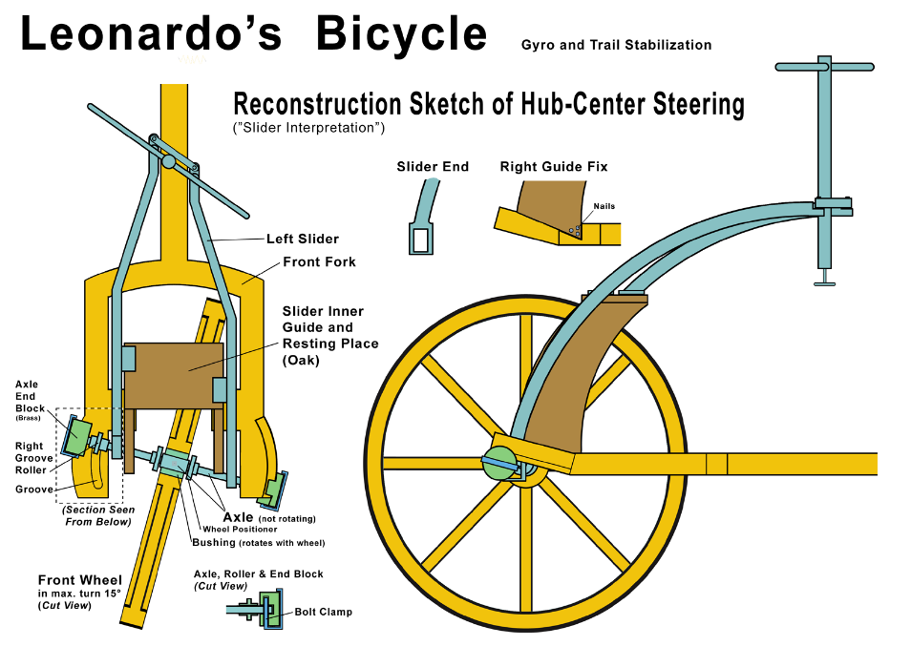
Leonardo DaVinci
Leonardo da Vinci was a great scientist and artist. He dissected corpses and was an inventor and engineer.
Da Vinci showed intellectual genius and his insightful talent through his sketches and artwork.

Slide 14
Literature and Ideas
Advances in cartography (the art of making maps) allowed exploration of new areas of the world.
Many works were written in the vernacular, or everyday language.
Dante Alighieri wrote The Divine Comedy, one of the world’s greatest poems. It was written in the vernacular.
Chaucer wrote The Canterbury Tales, a famous book.

Slide 15
More great ideas
Johannes Gutenberg developed a printing press with movable metal type, so more books could be printed more quickly. This helped spread humanist ideas.
William Shakespeare was the greatest writer of the era.
  Actor and poet
  Hamlet, Macbeth, Romeo and Juliet, and more!
Miguel Cervantes wrote plays and a novel called Don Quixote de la Mancha.

Slide 16
Section 2 Questions
Complete questions 1, 2, 4, and 5 on page 400 of your social studies textbook.

Slide 17
Chapter 7, Section 3 Terms
Sandro Botticelli
Raphael Sanzio
Michaelangelo Buonarroti
Titian
Jan van Eyck
Albrecht Durer
Chiaroscuro
Fresco
Oil painting
For the people, why are they important? What did they do?
Section 3 Questions pg. 413 #1,2,4

Slide 18
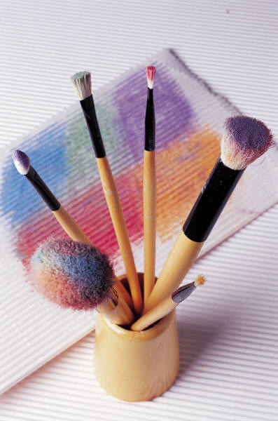
Artists in Renaissance Italy
Renaissance art:
  Showed people as they would appear in real life
  Tried to show people’s emotions
  New techniques, like perspective (makes it look 3D)
  Used chiaroscuro (creating drama and emotion using light and shadows)
  Used fresco (painting wet plaster with watercolor paint)

Slide 19
Artists and their works
Botticelli- fresco artist (wet plaster and watercolors), painted in churches in Italy, and the Sistine Chapel
Da Vinci- artist (and scientist and inventor), painted The Last Supper, Mona Lisa
Raphael- painted gentle Madonnas, School of Athens
Michaelangelo- painted, sculpted, and designed buildings, painted the ceiling of the Sistene Chapel in Rome, David statue (13 feet tall)
Titian- painted portraits, mythical and religious scenes

Slide 20
Spread of the Renaissance
Oil painting, started in Flanders, lets artists paint intricate details and surface textures.
Jan Van Eyck- master of oil painting, colors sparkled like jewels or stained glass.
Albrecht Durer- master of perspective and fine detail, and engravings (carving on metal, wood, or stone)
Renaissance reached England in the late 1500’s. This is called the Northern Renaissance.
  Affected writing, theater, printing press helped create more literature

Slide 21
Artists and their Techniques
Artist | Technique
Leonardo da Vinci
Michelangelo
Jan Van Eyck
Albrecht Durer

Slide 22
Section 3 Questions
Complete questions 1,2, and 4 on pg. 413

